Slide 1
Degree Distributions

Slide 2

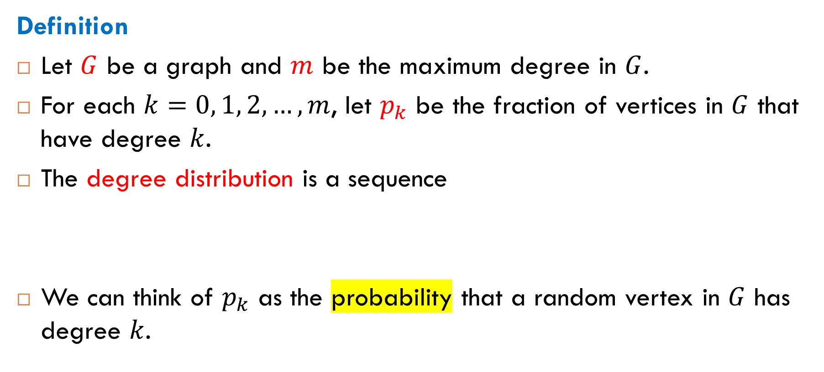
What Is a Degree Distribution?
Definition
Let $G$ be a graph and $m$ be the maximum degree in $G$.
For each $k=0, 1, 2, …, m$, let $p_{k}$ be the fraction of vertices in $G$ that have degree $k$.
The degree distribution is a sequence
We can think of $p_{k}$ as the probability that a random vertex in $G$ has degree $k$.
$$p_{0}, p_{1}, …, p_{m}$$

Slide 3
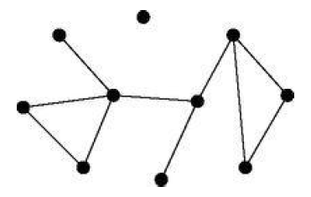

Example
$$p_{0}=0.1$$
$$p_{1}=0.2$$
$$p_{2}=0.4$$
$$p_{3}=0.2$$
$$p_{4}=0.1$$

Slide 4
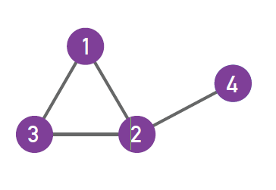

Exercise: Find Degree Distribution
$$p_{0}=0$$
$$p_{1}=0.25$$
$$p_{2}=0.5$$
$$p_{3}=0.25$$

Slide 5
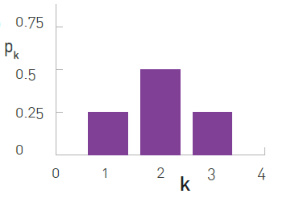
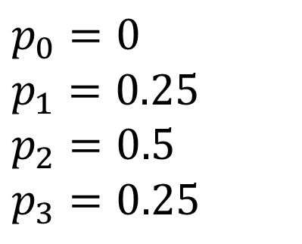
Histogram Representation
of Degree Distribution
$$p_{0}=0$$
$$p_{1}=0.25$$
$$p_{2}=0.5$$
$$p_{3}=0.25$$

Slide 6
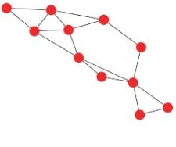
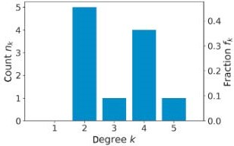
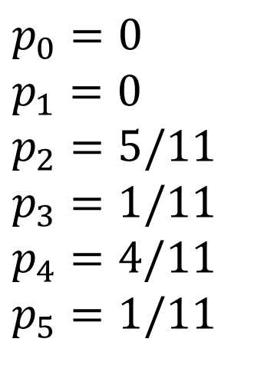
Another Example
$$p_{0}=0$$
$$p_{1}=0$$
$$p_{2}=5/11$$
$$p_{3}=1/11$$
$$p_{4}=4/11$$
$$p_{5}=1/11$$

Slide 7
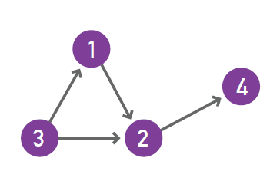
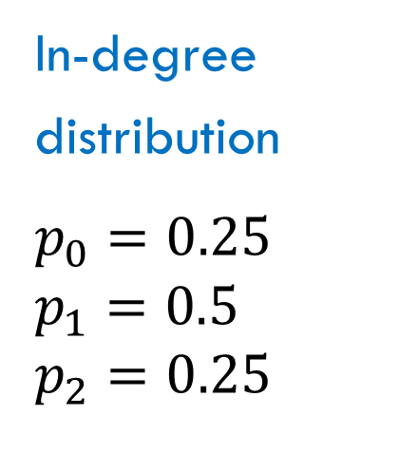
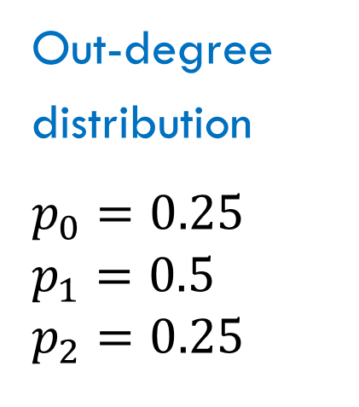
Degree Distributions for Directed Graphs
A directed graph has an in-degree distribution and an out-degree distribution defined in a similar way.
Example
In-degree
distribution
$$p_{0}=0.25$$
$$p_{1}=0.5$$
$$p_{2}=0.25$$
Out-degree
distribution
$$p_{0}=0.25$$
$$p_{1}=0.5$$
$$p_{2}=0.25$$

Slide 8
Degrees in Random Graphs

Slide 9
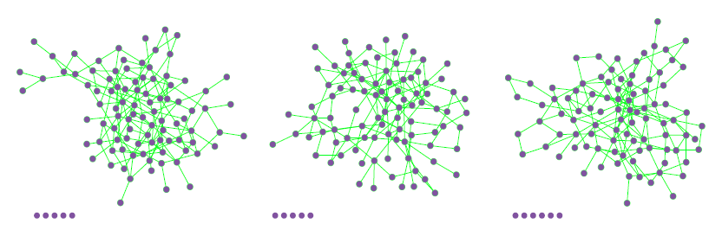

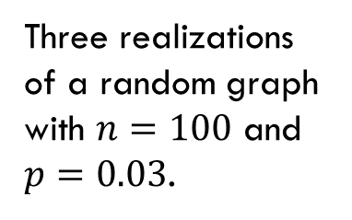
Random Graphs
What is the degree distribution in a random graph?
The $G(n,p)$ model of random graphs: We have $n$ vertices and we place an edge between each pair of distinct vertices with independent probability $p$.
Three realizations of a random graph with $n=100$ and $p=0.03$.

Slide 10
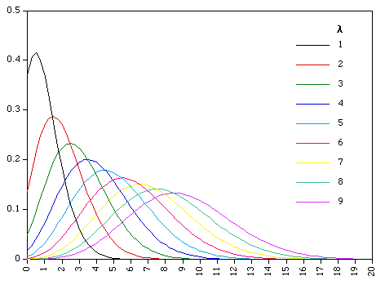
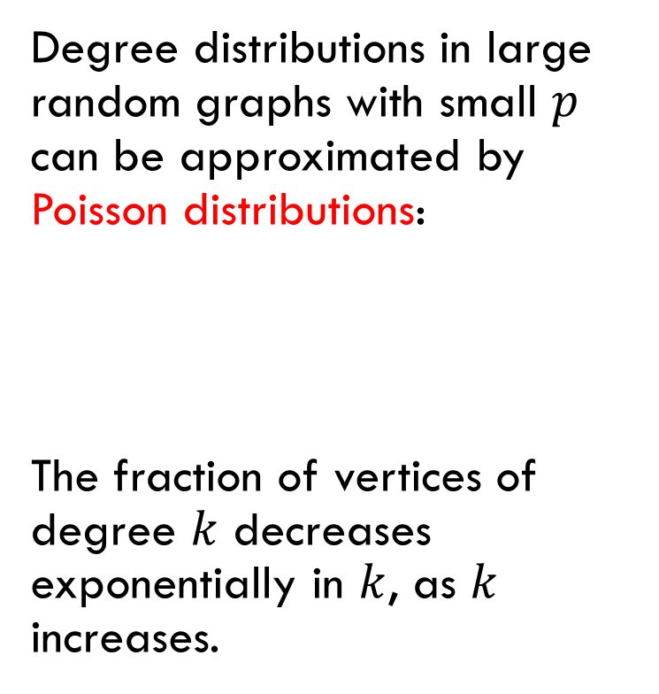


Degree Distribution in Large Random Graphs
Degree distributions in large random graphs with small $p$ can be approximated by Poisson distributions:
The fraction of vertices of degree $k$ decreases exponentially in $k$, as $k$ increases.
$$λ=pn$$
$$p_{k}→\frac{λ^{k}e^{−λ}}{k!}$$

Slide 11
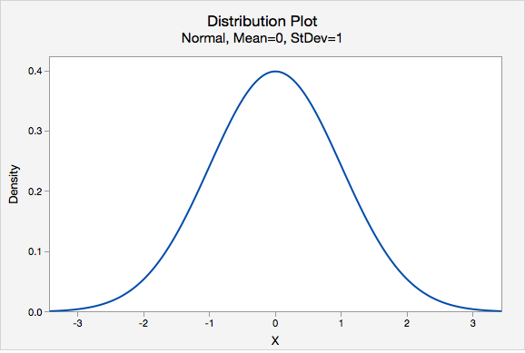
Normal Distributions
Basic fact about normal distributions: Any quantity that can be viewed as the sum of many small independent effects will be well approximated by a normal distribution.
exponential decrease

Slide 12
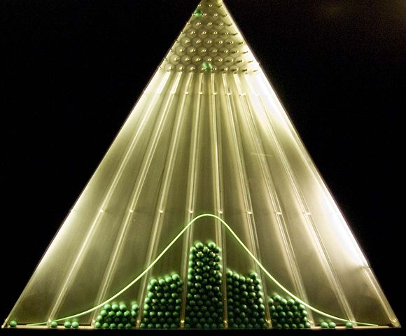
Illustration: Bell Curve
The Bean Machine
(Francis Galton)
Small balls are dropped from the top and then bounce randomly left or right as they hit the pins.
The balls are collected into bins at the bottom and settle down into a pattern resembling the Gaussian curve.

Slide 13
Degrees in Real-World Networks

Slide 14
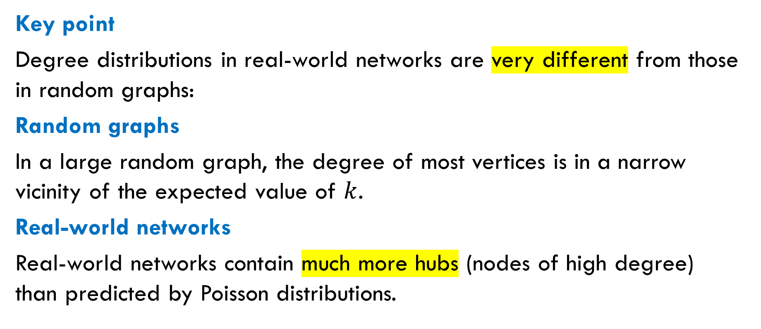
Real-World Networks Versus Random Graphs
Key point
Degree distributions in real-world networks are very different from those in random graphs:
Random graphs
In a large random graph, the degree of most vertices is in a narrow vicinity of the expected value of $k$.
Real-world networks
Real-world networks contain much more hubs (nodes of high degree) than predicted by Poisson distributions.

Slide 15
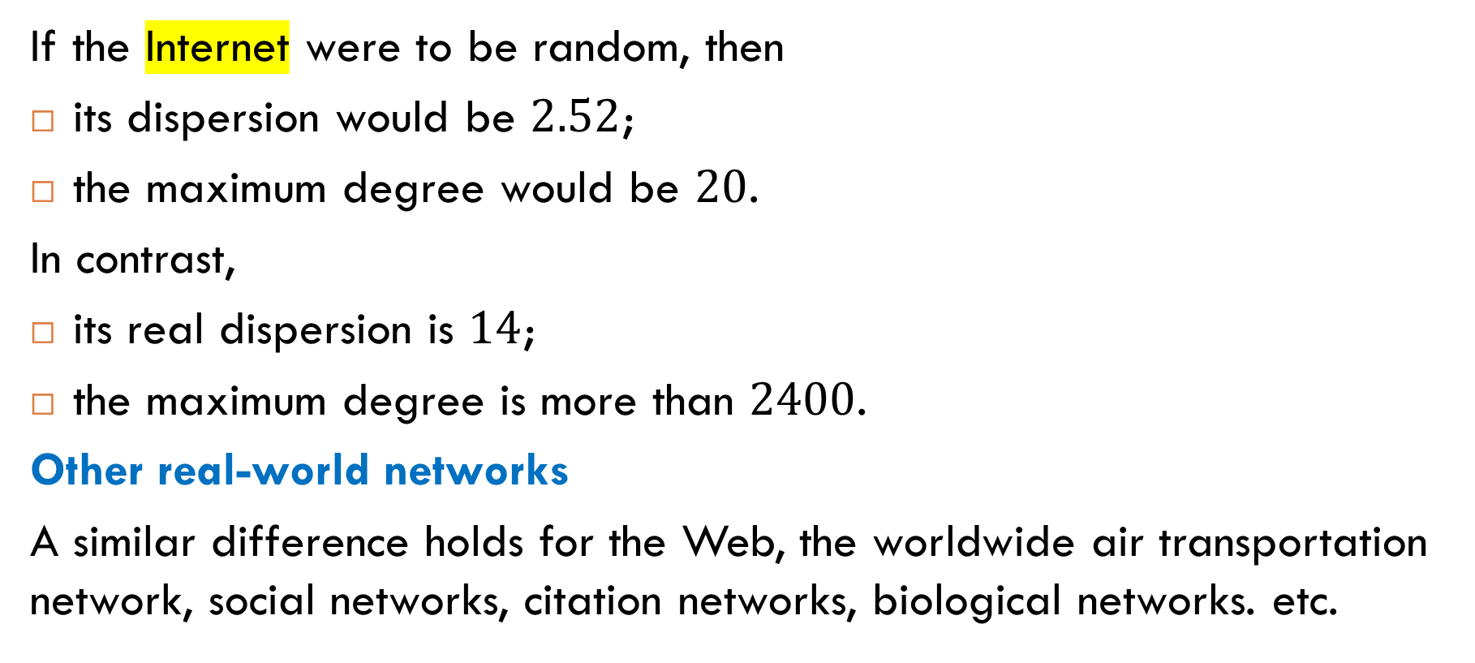
Examples
If the Internet were to be random, then
its dispersion would be $2.52$;
the maximum degree would be $20$.
In contrast,
its real dispersion is $14$;
the maximum degree is more than $2400$.
Other real-world networks
A similar difference holds for the Web, the worldwide air transportation network, social networks, citation networks, biological networks. etc.

Slide 16
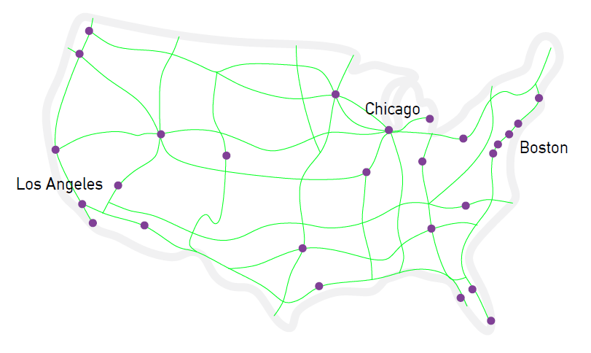
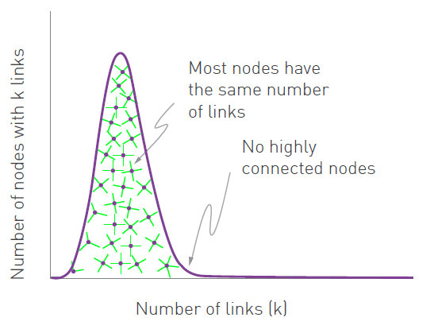
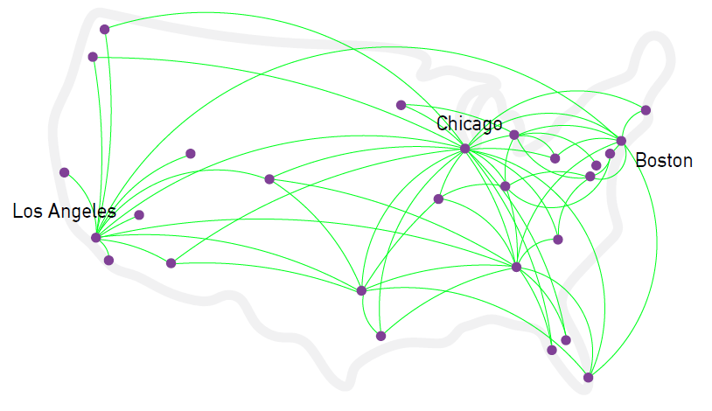
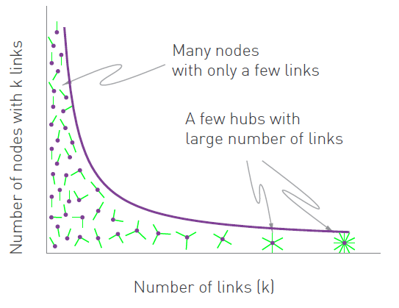
random graph
real world network

Slide 17
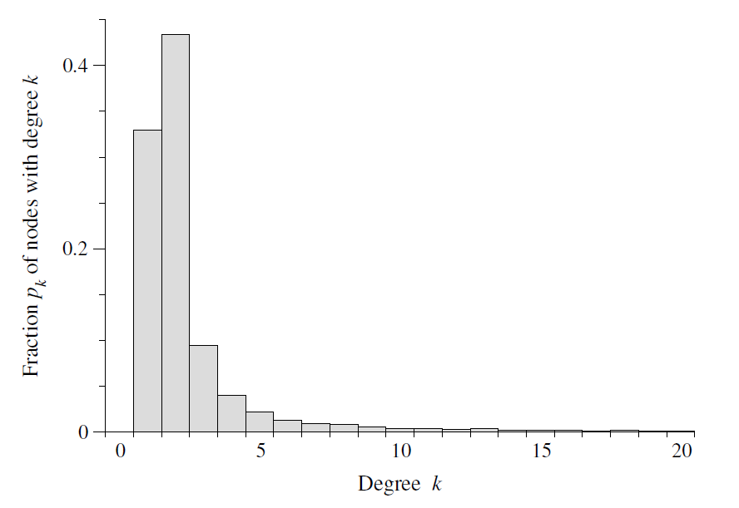
The Internet
A histogram of the degree distribution on the Internet at the level of autonomous systems.

Slide 18
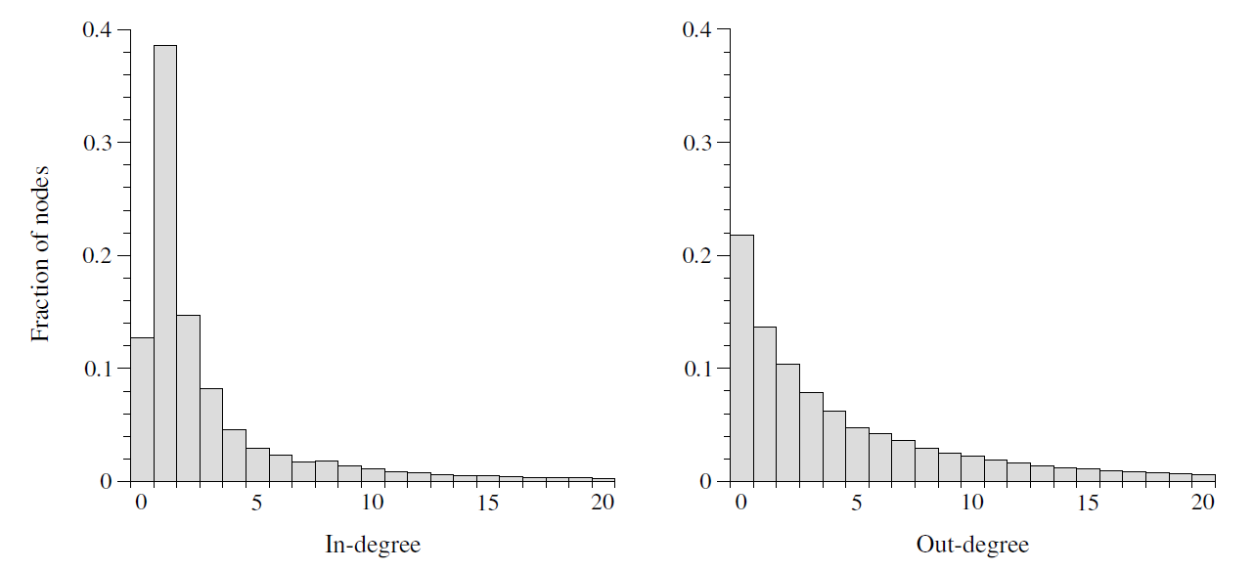
In-Degrees and Out-Degrees on the Web

Slide 19
Double Logarithmic Plots
Log-Log Plots

Slide 20
Plotting Distribution Curves
Problem. When plotting a curve that includes very small and very large values at the same axis, differences between small values are indistinguishable.
Solution. Plotting in logarithmic scale: instead of using the original values as axis coordinates, we use their logarithms.
Terminology. Such plots are called double logarithmic plots or log-log plots.
Benefits. Large range of values are represented more effectively:
small differences are amplified in the range of small values;
large differences are compressed in the range of large values.

Slide 21
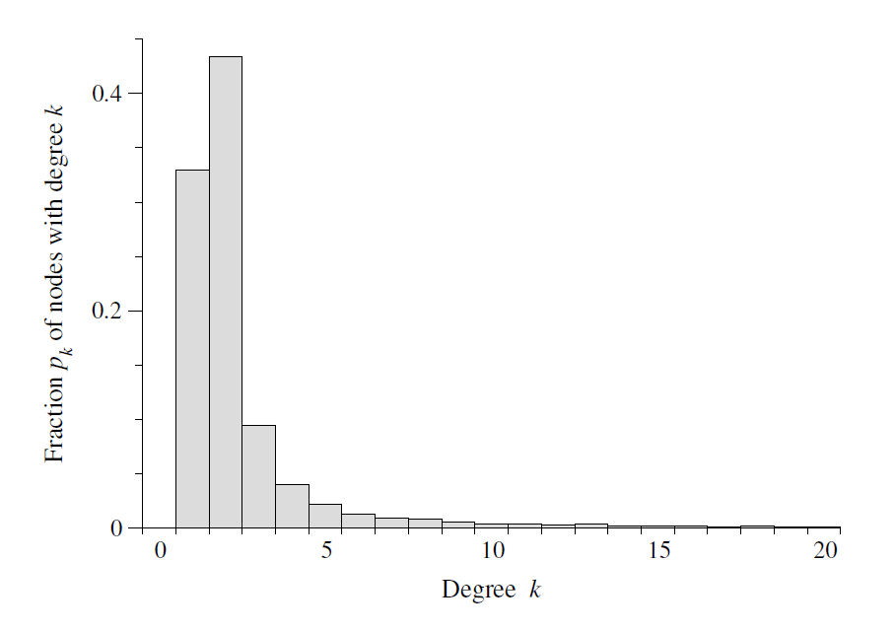
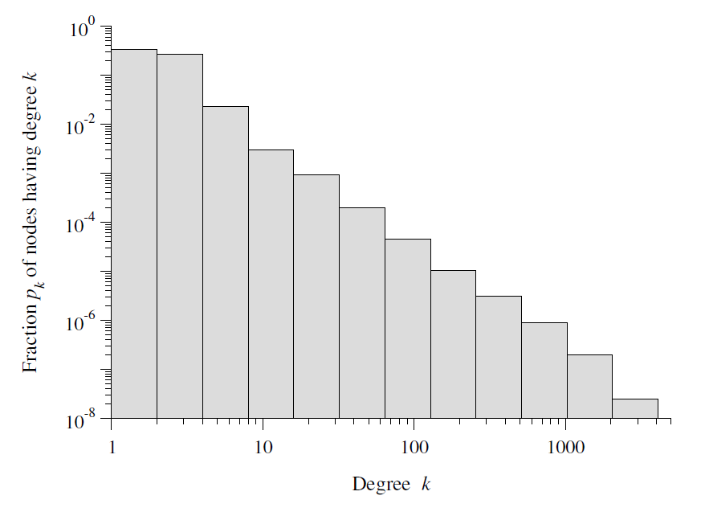
Example
The degree distribution on the Internet at the level of autonomous systems.
log-log histogram

Slide 22
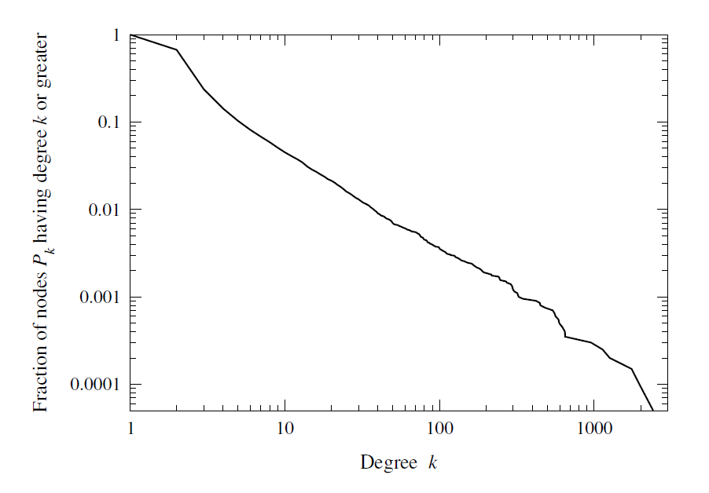
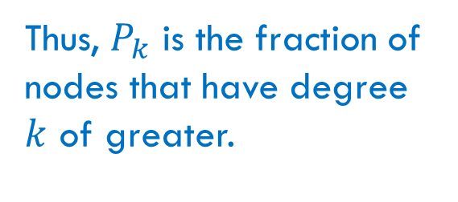
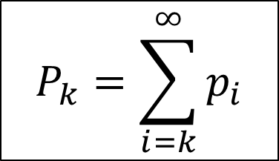
Cumulative Distribution
$$P_{k}=\sum_{i=k}^{∞}{p_{i}}$$
Thus, $P_{k}$ is the fraction of nodes that have degree $k$ of greater.
The cumulative degree distribution on the Internet at the level of autonomous systems.

Slide 23
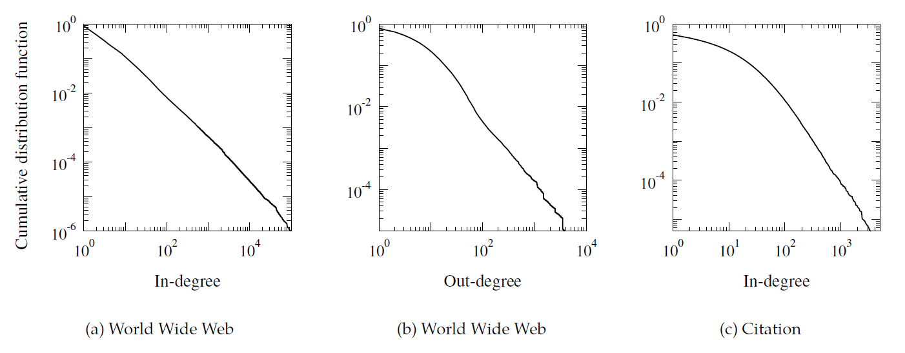
More Examples of Cumulative Distributions

Slide 24
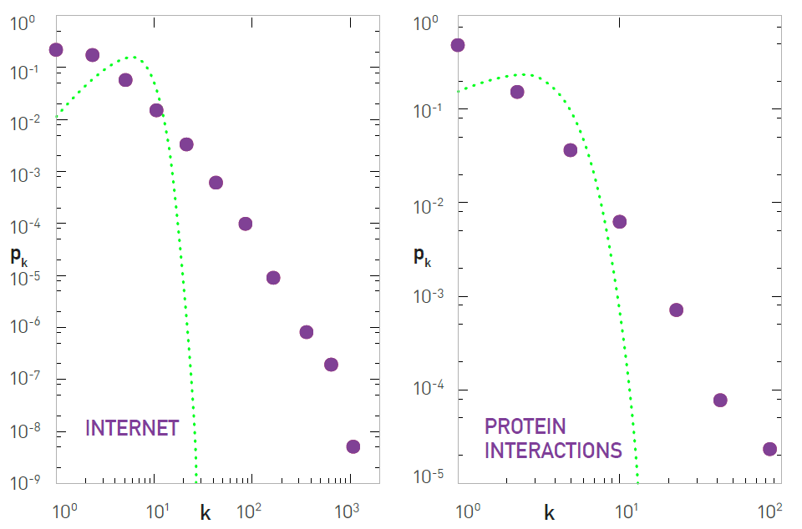
Poisson Versus Power Law

Slide 25
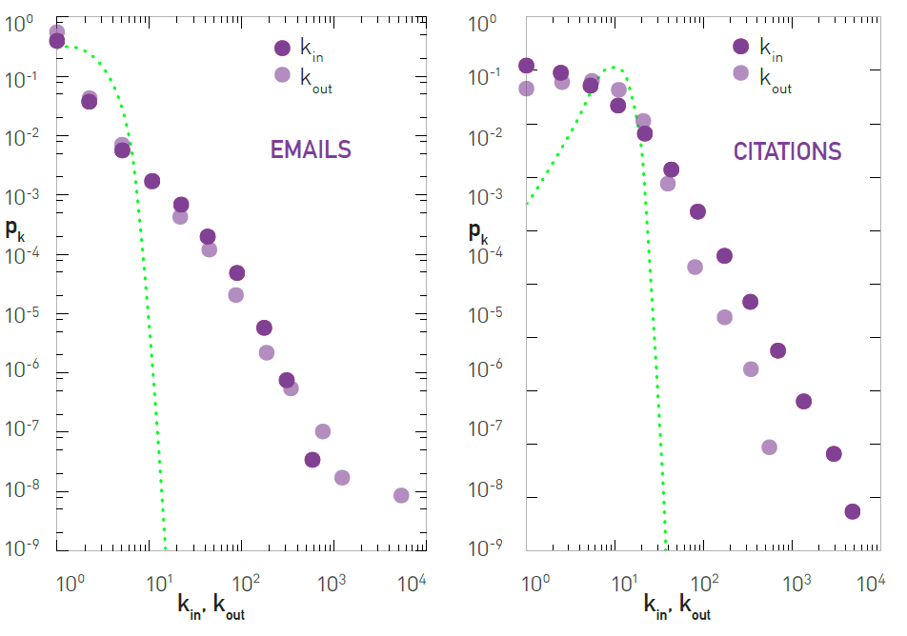
Poisson Versus Power Law

Slide 26
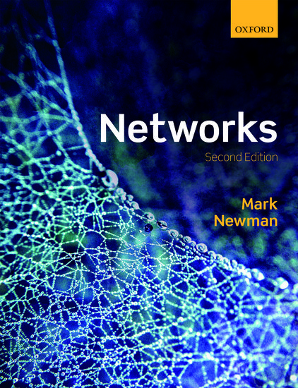
Reading
Section 10.3

